Slide 1
Descriptive Analytics II: Business Intelligence and Data Warehousing

Slide 2
3.2 Business Intelligence and Data Warehousing
Descriptive analytics (i.e., BI) is the entry level in the business analytics taxonomy. It is often called business reporting because of the fact that most of the analytics activities at this level deal with creating reports to summarize business activities to answer questions such as
- “What happened?”
- “What is happening?”
The spectrum of these reports includes static snapshots of business transactions delivered to knowledge workers (i.e., decision makers) on a fixed schedule (e.g., daily, weekly, quarterly); ad hoc reporting where the decision maker is given the capability of creating his or her own specific report (using an intuitive drag-and-drop graphical user interface) to address a specific or unique decision situation; and dynamic views of key business performance indicators delivered to managers and executives in an easily digestible form (e.g., dashboard-looking graphical interfaces) on a continuous manner.

Slide 3
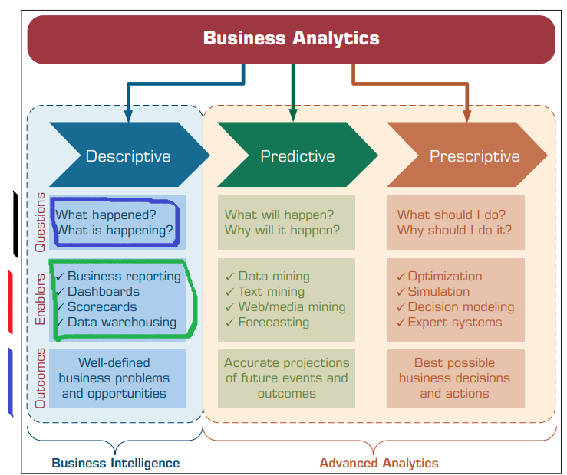
Generally speaking, and as depicted in the given figure, BI systems rely on a data warehouse as the information source for creating insight and supporting managerial decision.

Slide 4
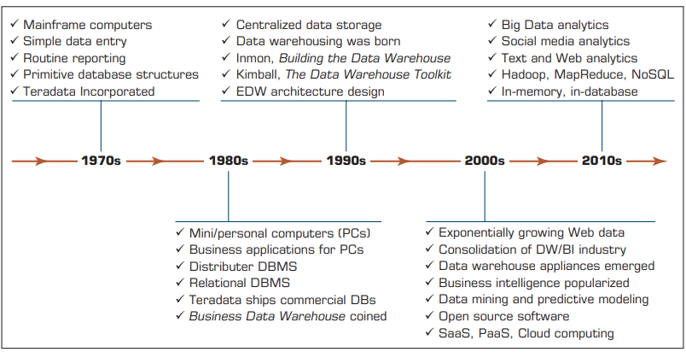
What Is a Data Warehouse?
In simple terms, a data warehouse (DW) is a pool of data produced to support decision making; it is also a repository of current and historical data of potential interest to managers throughout the organization. Data are usually structured to be available in a form ready for analytical processing activities (i.e., online analytical processing [OLAP], data mining, querying, reporting, and other decision support applications).
A data warehouse is a
subject-oriented, integrated,
time-variant, nonvolatile
collection of data
in support of management’s
decision-making process.

Slide 5
Characteristics of Data Warehousing
Subject oriented. Data are organized by detailed subject, such as sales, products, or customers, containing only information relevant for decision support.
Integrated. Integration is closely related to subject orientation. Data warehouses must place data from different sources into a consistent format. To do so, they must deal with naming conflicts and discrepancies among units of measure. A data warehouse is presumed to be totally integrated.
Time variant (time series). A warehouse maintains historical data. The data do not necessarily provide current status (except in real-time systems). They detect trends, deviations, and long-term relationships for forecasting and comparisons, leading to decision making. Every data warehouse has a temporal quality.
Nonvolatile. After data are entered into a data warehouse, users cannot change or update the data.

Slide 6
Some additional characteristics may include the following --
• Web based. Data warehouses are typically designed to provide an efficient computing environment for Web-based applications.
• Relational/multidimensional. A data warehouse uses either a relational structure or a multidimensional structure. A recent survey on multidimensional structures can be found in Romero and Abelló (2009).
imp., selfstudy → https://www.gooddata.com/blog/relational-dimensional-data-models/
• Client/server. A data warehouse uses the client/server architecture to provide easy access for end users.
• Real time. Newer data warehouses provide real-time, or active, data-access and analysis capabilities (see Basu, 2003; Bonde & Kuckuk, 2004).
• Include metadata. A data warehouse contains metadata (data about data) about how the data are organized and how to effectively use them.

Slide 7
Data Marts (DM)
Whereas a data warehouse combines databases across an entire enterprise, a data mart (DM) is usually smaller and focuses on a particular subject or department.
A DM is a subset of a data warehouse, typically consisting of a single subject area (e.g., marketing, operations).
A DM can be either dependent or independent.
A dependent data mart is a subset that is created directly from the data warehouse. It has the advantages of using a consistent data model and providing quality data.
Dependent DMs support the concept of a single enterprise-wide data model, but the data warehouse must be constructed first.
A dependent DM ensures that the end user is viewing the same version of the data that is accessed by all other data warehouse users. The high cost of data warehouses limits their use to large companies.

Slide 8
An independent data mart is a small warehouse designed for a strategic business unit or a department, but its source is not an EDW.
EDW = ?
Operational Data Stores. An operational data store (ODS) provides a fairly recent form of customer information file. This type of database is often used as an interim staging area for a data warehouse. Unlike the static contents of a data warehouse, the contents of an ODS are updated throughout the course of business operations.
An ODS is used for short-term decisions involving mission-critical applications rather than for the medium- and long-term decisions associated with an EDW. An ODS is similar to short-term memory in that it stores only very recent information
In comparison, a data warehouse is like long-term memory because it stores permanent information. An ODS consolidates data from multiple source systems and provides a near–real-time, integrated view of volatile, current data.

Slide 9
Enterprise Data Warehouses (EDW)
An enterprise data warehouse (EDW) is a large-scale data warehouse that is used across the enterprise for decision support. The large-scale nature of an EDW provides integration of data from many sources into a standard format for effective BI and decision support applications.
EDWs are used to provide data for many types of decision support systems (DSS), including customer relationship management (CRM), supply chain management (SCM), business performance management (BPM), business activity monitoring, product life cycle management, revenue management, and sometimes even knowledge management systems.

Slide 10
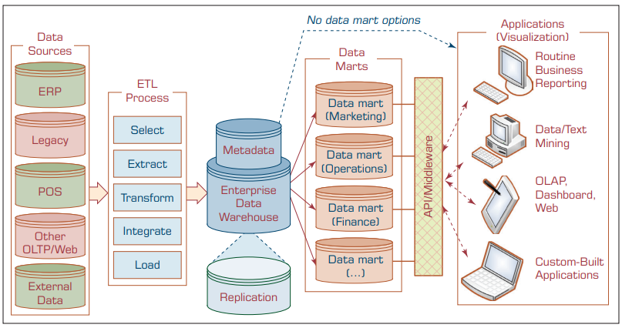
A Data Warehouse Framework and Views

